Slide 1

PENETRATION TESTING
Under the guidance of
Dr. Rajini S
Associate Professor
Dept. of ISE, VVCE
Team members:
CHIRANTH K N (4VV20IS029)
DARSHAN A S (4VV20IS032)
DARSHAN G R (4VV20IS034)
GURU PRUTHVI J M (4VV20IS042)

Slide 2
PROBLEM STATEMENT
In today's digital landscape, web applications have become a fundamental part of daily life, providing essential services such as online shopping, social networking, and financial transactions. However, the increasing complexity and interconnectedness of these applications expose them to a growing array of security threats and vulnerabilities. The problem at hand is the need to ensure the robust security of web applications in the face of evolving cyber threats to safeguard sensitive data, maintain user trust, and prevent potential financial losses and reputational damage.

Slide 3
OBJECTIVES
Identifying Vulnerabilities
Simulating Real-World Attacks
Mitigating Risks
Continuous Improvement

Slide 4
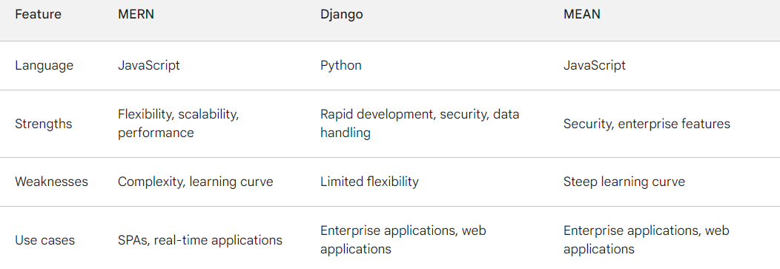
MERN VS DJANGO VS MEAN
Notes:
MERN is a JavaScript framework that stands for MongoDB, Express, React, and Node.js.
Django is a Python framework that is known for its rapid development, security, and data handling capabilities. It is a good choice for building a wide range of web applications
MEAN is a JavaScript framework that stands for MongoDB, Express, Angular, and Node.js. It is similar to MERN, but it uses Angular instead of React
Security: The robustness of the stack in protecting against vulnerabilities and ensuring data integrity.
Ease of development: The simplicity of the development process and the availability of resources and tools.

Slide 5
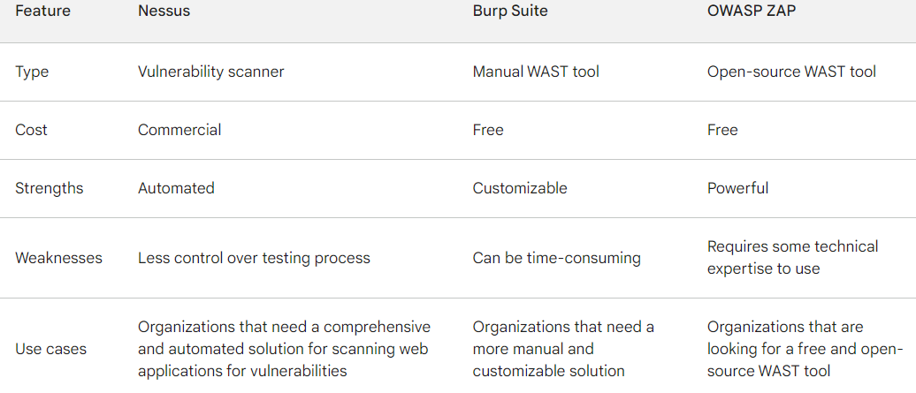
NESSUS VS BRUPSUITE VS OWASP ZAP

Slide 6

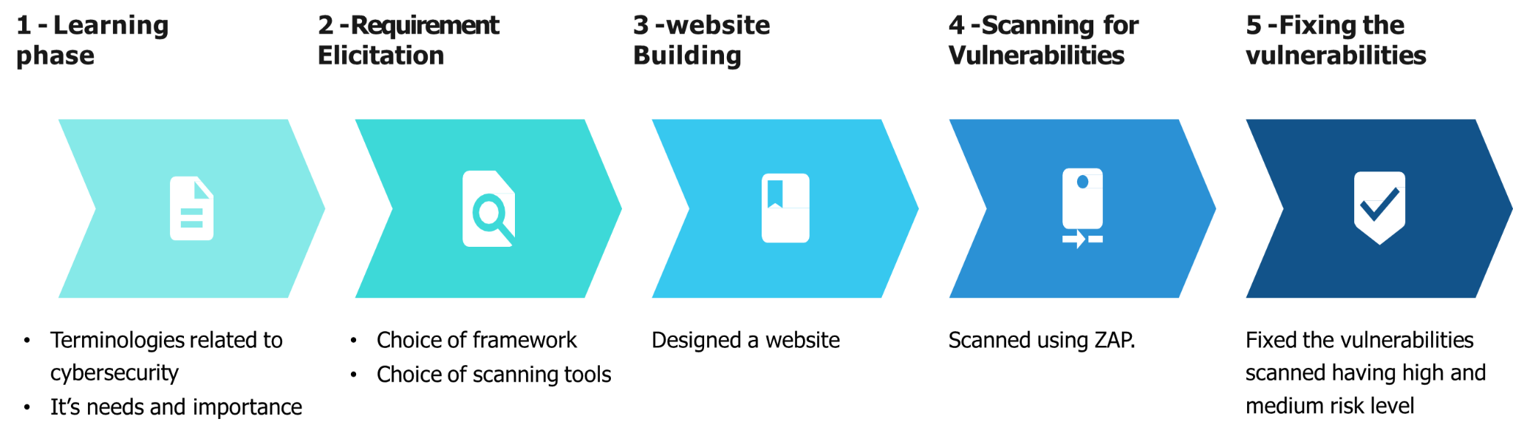
METHODOLOGY

Slide 7
LITERATURE SURVEY

Slide 8
REFERENCES
D. Vitek, Auditing Code for Security Vulnerabilities with CodeSonar. Boston, MA, USA: IEEE, 2016
Portswigger. Portswigger Web Security-BurpSuite. Accessed: Jan. 8, 2019.
G. A. Campbell and P. P. Papapetrou, Sonarqube in Action, Manning Publications Co., Greenwich, CT, USA, 2013
G. Lawton “Web 2.0 Creates Security Challenges” IEEE Computer Society , Vol.40 (10) pp. 13 – 16, 2007

Slide 9
THANK YOU

